Slide 1
Async Programming in JavaScript
Jafar Husain
@jhusain

Slide 2
Who am I?
Cross-Team Technical Lead for Netflix UIs
Architect of Netflix UI Data Platform
Member of JavaScript standards committee (TC39)
16 years in the industry, formerly worked at Microsoft and GE
Notes:
Cross-Team Technical Lead for Netflix UI’s
12 years in the industry, formerly worked at Microsoft and GE
4 years of experience building systems with Functional Reactive Programming

Slide 3
Today I’m going to teach you how to solve
BIG async problems
by thinking differently about
Events.

Slide 4
Async Programming seems
HARD

Slide 5
Async seems Hard
Race Conditions
Memory Leaks
Complex State Machines
Uncaught Async Errors

Slide 6
Playing a Movie Asynchronously
function play(movieId, cancelButton, callback) {
var movieTicket,
playError,
tryFinish = function() {
if (playError) {
callback(null, playError);
}
else if (movieTicket && player.initialized) {
callback(null, ticket);
}
};
cancelButton.addEventListener(“click”, function() { playError = “cancelled”; }
if (!player.initialized) {
player.init(function(error) {
playError = error;
tryFinish();
}
}
authorizeMovie(function(error, ticket) {
playError = error;
movieTicket = ticket;
tryFinish();
});
});
function play(movieId, cancelButton, callback) {
var movieTicket,
playError,
tryFinish = function() {
if (playError) {
callback(null, playError);
}
else if (movieTicket && player.initialized) {
callback(null, ticket);
}
};
cancelButton.addEventListener(“click”, function() { playError = “cancelled”; }
if (!player.initialized) {
player.init(function(error) {
playError = error;
tryFinish();
});
}
authorizeMovie(function(error, ticket) {
playError = error;
movieTicket = ticket;
tryFinish();
});
});
function play(movieId, cancelButton, callback) {
var movieTicket,
playError,
tryFinish = function() {
if (playError) {
callback(null, playError);
}
else if (movieTicket && player.initialized) {
callback(null, ticket);
}
};
cancelButton.addEventListener(“click”, function() { playError = “cancelled”; }
if (!player.initialized) {
player.init(function(error) {
playError = error;
tryFinish();
});
}
authorizeMovie(function(error, ticket) {
playError = error;
movieTicket = ticket;
tryFinish();
});
});
function play(movieId, cancelButton, callback) {
var movieTicket,
playError,
tryFinish = function() {
if (playError) {
callback(null, playError);
}
else if (movieTicket && player.initialized) {
callback(null, ticket);
}
};
cancelButton.addEventListener(“click”, function() { playError = “cancelled”; }
if (!player.initialized) {
player.init(function(error) {
playError = error;
tryFinish();
}
}
authorizeMovie(function(error, ticket) {
playError = error;
movieTicket = ticket;
tryFinish();
});
});

Slide 7
I’m going to show you how to write complex async programs using just a few flexible functions.

Slide 8


But first a brief
JavaScript 6 tutorial…

Slide 9
Functions
function(x, y) { return x + y; }
function(x) { return x + 1; }
x
=>
x + 1
(x, y)
=>
x + y
JS
5
6

Slide 10
Fin.

Slide 11
ForEach
> [1, 2, 3].forEach(x => console.log(x))
> 1
> 2
> 3
>

Slide 12
Map

Slide 13
Map
> [1, 2, 3].map(x => x + 1)
> [2, 3, 4]
>

Slide 14
Filter

Slide 15
Filter
> [1, 2, 3].filter(x => x > 1)
> [2, 3]
>

Slide 16
concatAll

Slide 17
concatAll
> [ [1], [2, 3], [], [4] ].concatAll()
> [1, 2, 3, 4]
>

Slide 18
Map/Filter/ConcatAll
> [1, 2, 3].map(x => x + 1)
> [2, 3, 4]
> [1, 2, 3].filter(x => x > 1)
> [2, 3]
> [ [1], [2, 3], [], [4] ].concatAll()
> [1, 2, 3, 4]
>

Slide 19
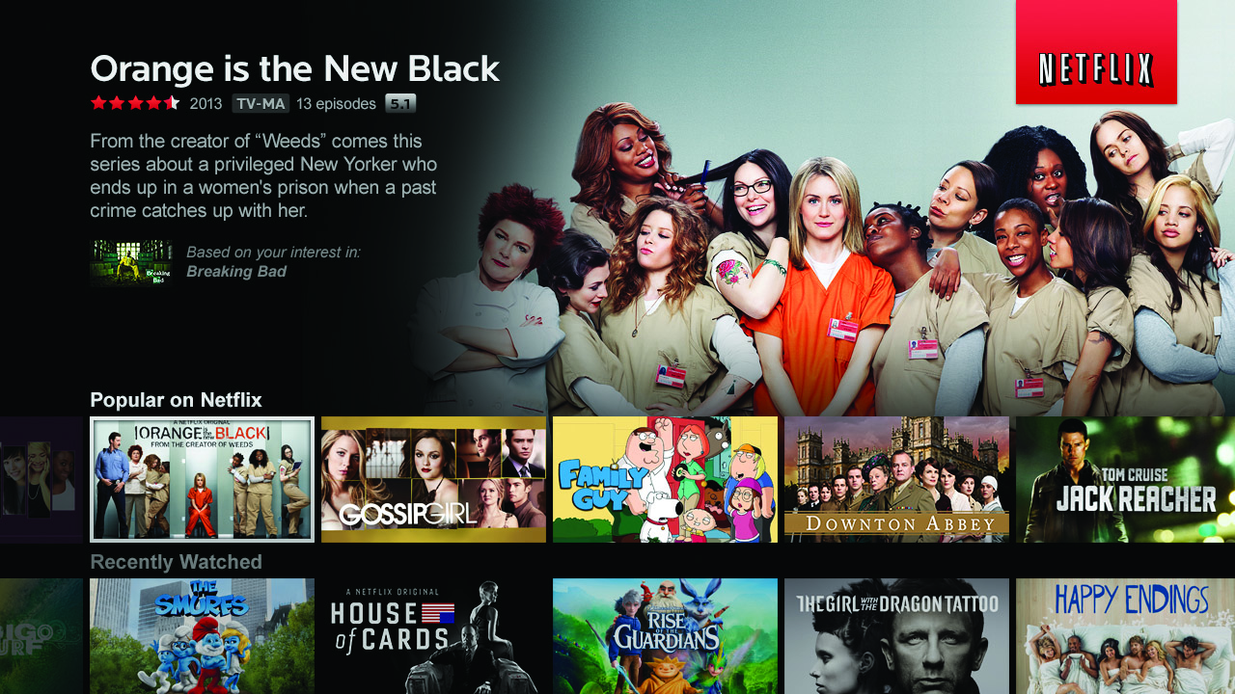

Slide 20
Let’s use map, filter, and concatAll to get a list of your favorite Netflix titles.

Slide 21
Top-rated Movies Collection
var getTopRatedFilms = user =>
user.videoLists.
map(videoList =>
videoList.videos.
filter(video => video.rating === 5.0)).
concatAll();
getTopRatedFilms(user).
forEach(film => console.log(film));

Slide 22
What if I told you…
…that you could create a drag event…
…with nearly the same code?

Slide 23



Top-rated Movies Collection
var getTopRatedFilms = user =>
user.videoLists.
map(videoList =>
videoList.videos.
filter(video => video.rating === 5.0)).
concatAll();
getTopRatedFilms(user).
forEach(film => console.log(film));

Slide 24

Mouse Drags Collection
var getElementDrags = elmt =>
elmt.mouseDowns.
map(mouseDown =>
document.mouseMoves.
filter takeUntil(document.mouseUps)).
concatAll();
getElementDrags(image).
forEach(pos => image.position = pos);

Slide 25
“What’s the difference between an Array…
[{x: 23, y: 44}, {x:27, y:55}, {x:27, y:55}]

Slide 26
… and an Event?
{x: 23, y: 44}...{x:27, y:55}.... {x:27, y:55}......

Slide 27
Events and Arrays are both collections.

Slide 28
So why don’t we program
them the same way?

Slide 29


Slide 30
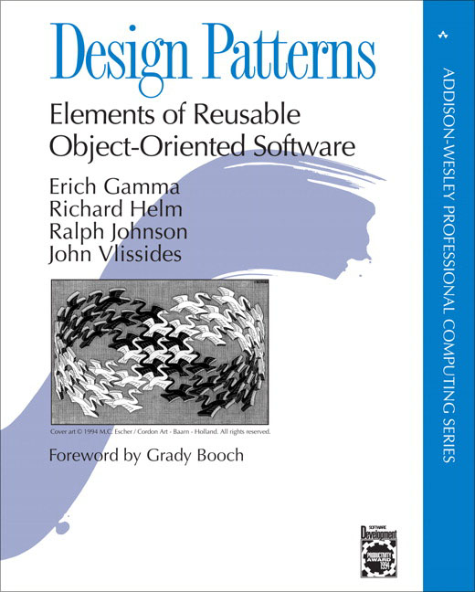

Slide 31
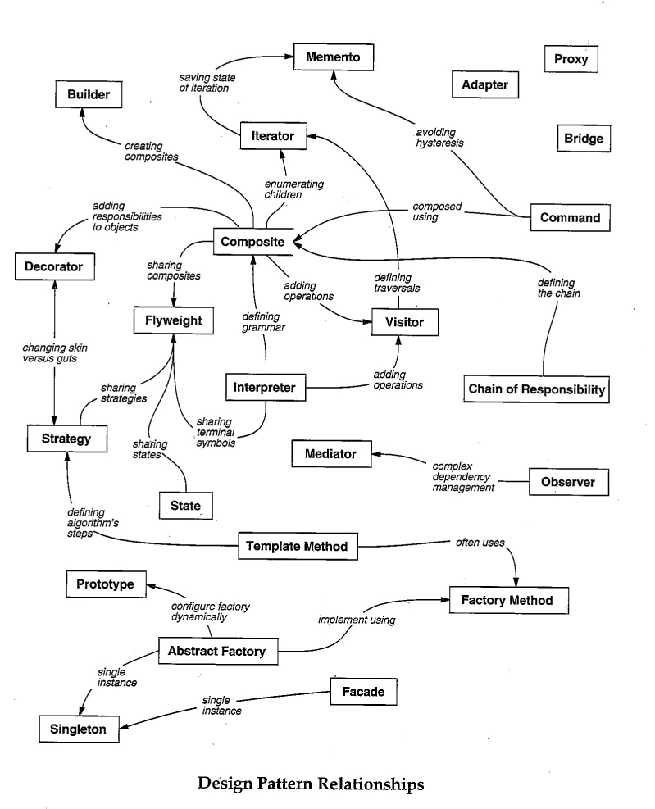
Iterator
?
Observer

Slide 32
Iterator
> var iterator = [1,2,3].iterator();
> console.log(iterator.next());
> { value: 1, done: false }
>
> console.log(iterator.next());
> { value: 2, done: false }
>
> console.log(iterator.next());
> { value: 3, done: false }
>
> console.log(iterator.next());
> { done: true }
>

Slide 33
Map, Filter, and ConcatAll can be implemented using an Iterator.

Slide 34
Observer Pattern
> document.addEventListener(
“mousemove”,
function next(e) {
console.log(e);
});
> { clientX: 425, clientY: 543 }
> { clientX: 450, clientY: 558 }
> { clientX: 455, clientY: 562 }
> { clientX: 460, clientY: 743 }
> { clientX: 476, clientY: 760 }
> { clientX: 476, clientY: 760 }
> { clientX: 476, clientY: 760 }
> { clientX: 476, clientY: 760 }

Slide 35
Iterator
progressively send information to consumer
Observer

Slide 36

The Iterator and Observer Pattern are Symmetrical.

Slide 37
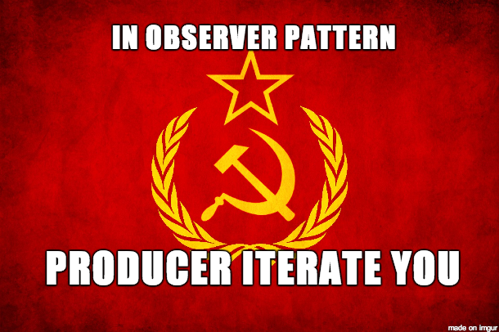

Slide 38
The authors of “Design Patterns” missed this symmetry.

Slide 39
As a result, they gave
Iterator and Observer
different semantics.

Slide 40
So Many Push APIs
DOM Events
Websockets
Server-sent Events
Node Streams
Service Workers
jQuery Events
XMLHttpRequest
setInterval

Slide 41
Introducing Observable
Observable === Collection + Time

Slide 42
Observables can model…
Events
Async Server Requests
Animations

Slide 43

Reactive Extensions
Events as Streams
Open Source (Apache2)
Ported to many languages
C
.NET
JavaScript
Java (Netflix)
Objective-C

Slide 44
http://reactivex.io

Slide 45
Events to Observables
var mouseMoves =
Observable.
fromEvent(element, “mousemove”);

Slide 46
Adapt Push APIs to Observable
DOM Events
Websockets
Server-sent Events
Node Streams
Observable
Service Workers
jQuery Events
XMLHttpRequest
setInterval

Slide 47
Event Subscription
// “subscribe”
var handler = (e) => console.log(e);
document.addEventListener(“mousemoves”, handler);
// “unsubscribe”
document.removeEventListener(“mousemoves”, handler);

Slide 48
Observable.forEach
// “subscribe”
var subscription =
mouseMoves.forEach(console.log);
// “unsubscribe”
subscription.dispose();

Slide 49
Expanded Observable.forEach
// “subscribe”
var subscription =
mouseMoves.forEach(
// next data
event => console.log(event),
// error
error => console.error(error),
// completed
() => console.log(“done”));
// “unsubscribe”
subscription.dispose();
optional

Slide 50
Expanded Observable.forEach
// “subscribe”
var subscription =
mouseMoves.forEach({
onNext: event => console.log(event),
// error
onError: error => console.error(error),
// completed
onCompleted: () => console.log(“done”)
});
// “unsubscribe”
subscription.dispose();
Observer

Slide 51
Converting Events to Observables
Observable.fromEvent = function(dom, eventName) {
// returning Observable object
return {
forEach: function(observer) {
var handler = (e) => observer.onNext(e);
dom.addEventListener(eventName, handler);
// returning Subscription object
return {
dispose: function() {
dom.removeEventListener(eventName, handler);
}
};
}
};
}

Slide 52
Observable Literal
{1……2…………3}
time
JS6

Slide 53
ForEach
> {1……2…………3}.forEach(console.log)
> {1……2…………3}
time
> 2
>
> 3
>
> 1
>

Slide 54
Map
> {1……2…………3}.map(x => x + 1)
time
> 3
>
> 4
>
> 2
>

Slide 55
Filter
> {1……2…………3}.filter(x => x + 1)
time
> 2
> 3
>
> 2
>
>

Slide 56
concatAll
[
[1]
[2, 3],
[],
[4]
].concatAll()
[1, 2, 3, 4]

Slide 57
concatAll
{
…{1}
………{2………………3},
……………{}
………………{4}
}.concatAll()
{…1…2………………3…4}
time

Slide 58
TakeUntil
{…1…2…………3}.takeUntil(
{……………4})
{…1…2…}
Source collection
time
Stop collection

Slide 59
Mouse Drags Collection
var getElementDrags = elmt =>
elmt.mouseDowns.
map(mouseDown =>
document.mouseMoves.
takeUntil(document.mouseUps)).
concatAll();
getElementDrags(image).
forEach(pos => image.position = pos);

Slide 60
mergeAll
{
…{1}
………{2………………3},
……………{}
………………{4}
}.mergeAll()
{…1…2……4………3}
time

Slide 61
switchLatest
{
…{1}
………{2………………3},
……………{}
………………{4}
}.switchLatest()
{…1…2……4}
time
subscription.dispose()

Slide 62
Don’t unsubscribe from Events.
Complete them when another event fires.

Slide 63
Mouse Drags Collection
var getElementDrags = elmt =>
elmt.mouseDowns.
map(mouseDown =>
document.mouseMoves.
takeUntil(document.mouseUps)).
concatAll();
getElementDrags(image).
forEach(pos => image.position = pos);

Slide 64
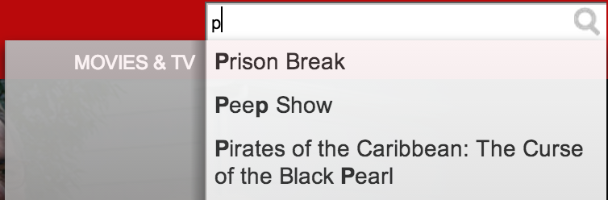
Netflix Search

Slide 65
Netflix Search
var searchResultSets =
keyPresses.
throttle(250).
map(key =>
getJSON(“/searchResults?q=” + input.value).
retry(3).
takeUntil(keyPresses)).
concatAll();
searchResultSets.forEach(
resultSet => updateSearchResults(resultSet),
error => showMessage(“the server appears to be down.”));

Slide 66
Netflix Search
var searchResultSets =
keyPresses.
throttle(250).
map(key =>
getJSON(“/searchResults?q=” + input.value).
retry(3).
takeUntil(keyPresses)).
concatAll switchLatest();
searchResultSets.forEach(
resultSet => updateSearchResults(resultSet),
error => showMessage(“the server appears to be down.”));

Slide 67
Netflix Search
var searchResultSets =
keyPresses.
throttle(250).
map(key =>
getJSON(“/searchResults?q=” + input.value).
retry(3)).
switchLatest();
searchResultSets.forEach(
resultSet => updateSearchResults(resultSet),
error => showMessage(“the server appears to be down.”));

Slide 68
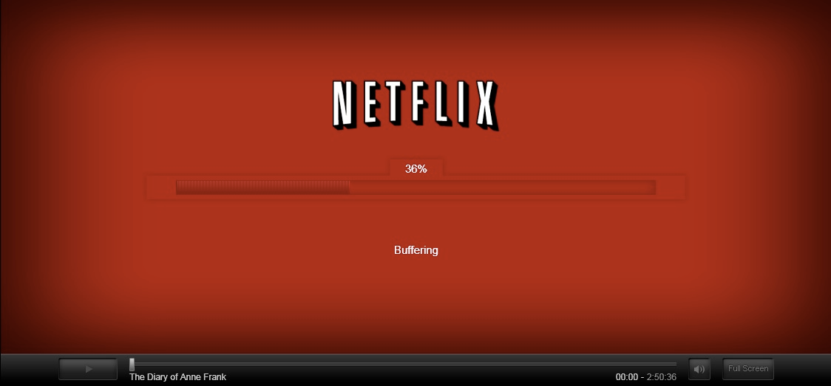
Netflix Player

Slide 69
Player Callback Hell
function play(movieId, cancelButton, callback) {
var movieTicket,
playError,
tryFinish = function() {
if (playError) {
callback(null, playError);
}
else if (movieTicket && player.initialized) {
callback(null, ticket);
}
};
cancelButton.addEventListener(“click”, function() { playError = “cancel”; });
if (!player.initialized) {
player.init(function(error) {
playError = error;
tryFinish();
}
}
authorizeMovie(movieId, function(error, ticket) {
playError = error;
movieTicket = ticket;
tryFinish();
});
});

Slide 70
Player with Observable
var authorizations =
player.
init().
map(() =>
playAttempts.
map(movieId =>
player.authorize(movieId).
catch(e => Observable.empty).
takeUntil(cancels)).
concatAll())).
concatAll();
authorizations.forEach(
license => player.play(license),
error => showDialog(“Sorry, can’t play right now.”));

Slide 71

Netflix: Observable Everywhere
App Startup
Player
Data Access
Animations
View/Model binding

Slide 72
Questions

Slide 73
Interactive Learning Exercises
http://jhusain.github.io/learnrx/

